Slide 1
Data analysis, DFT modeling, and INS simulation at VISION
Yongqiang (YQ) Cheng

Slide 2
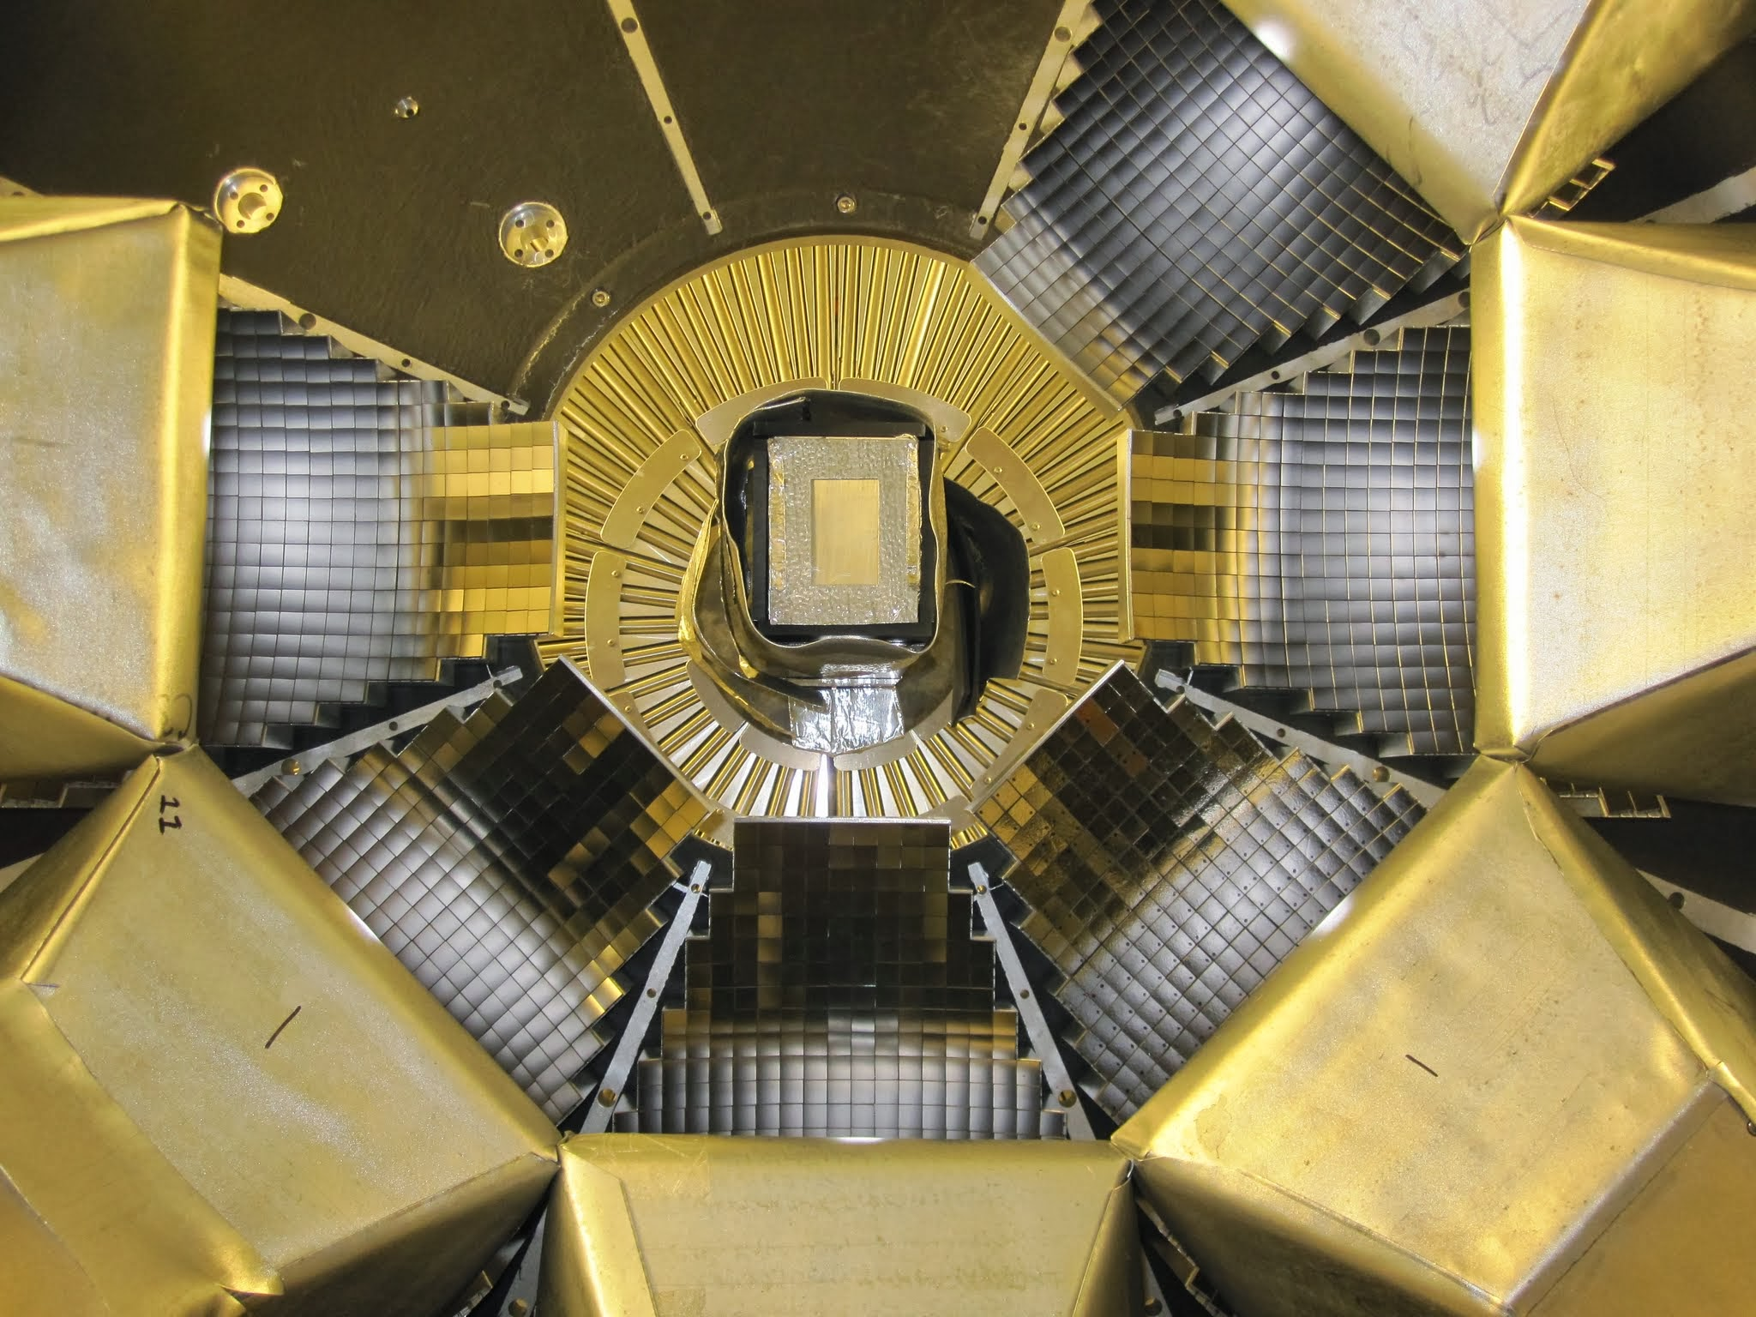
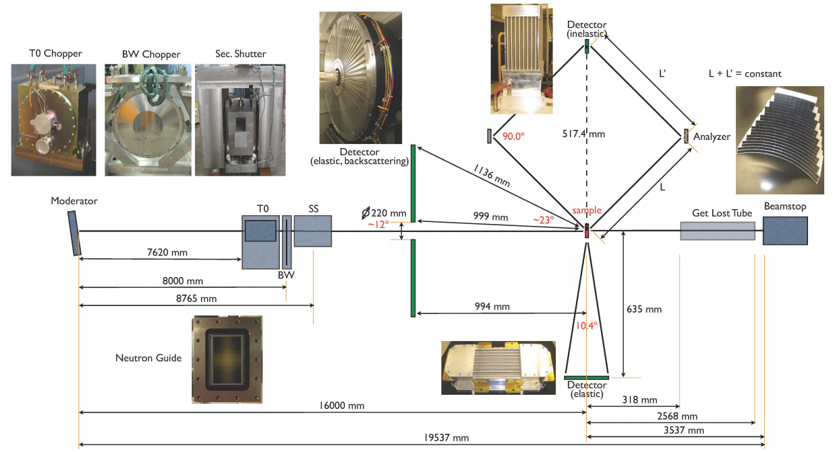
The VISION instrument
Chemistry Oriented INS spectrometer
White incident beam, fixed final energy (indirect geometry)
High flux and double-focusing
Broadband (-2 to 1000 meV at 30Hz, 5 to 500 meV at 60 Hz)
Constant △E/E throughout the spectrum (~1.5%)
Elastic line HMFW ~150 μeV
Backward and 90° diffraction banks

Slide 3
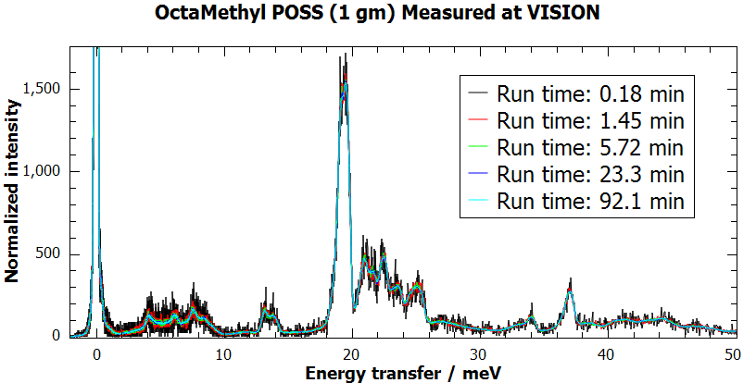
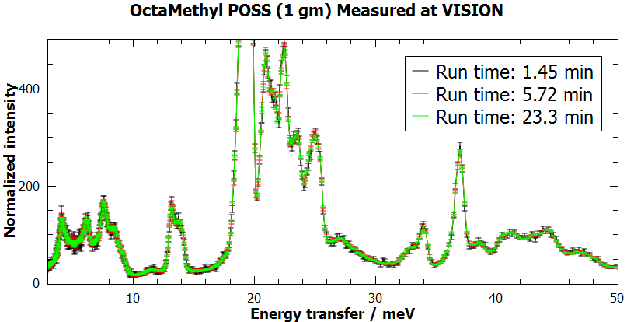
High throughput: INS in minutes
With 14 inelastic banks and 16 diffraction banks, VISION has the highest data rate of up to millions of events per second.

Slide 4
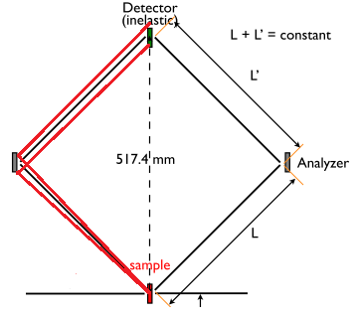
Data reduction at VISION
L+L’=L2
L1
Ideally Ef and L2 are constants, but in reality (due to the finite sizes of the sample, analyzer crystal, and detector), each pixel has its own combination of Ef and L2, such that the energy transfer at a particular pixel should be calculated using its own (Ef, L2).
(Ef, L2) for each pixel can be determined/calibrated by identifying and analyzing two known peaks in the spectrum of this pixel
14 INS detector banks (13 in place). Each detector bank has 8 tubes, and each tube has 128 pixels (14336 pixels in total).

Slide 5
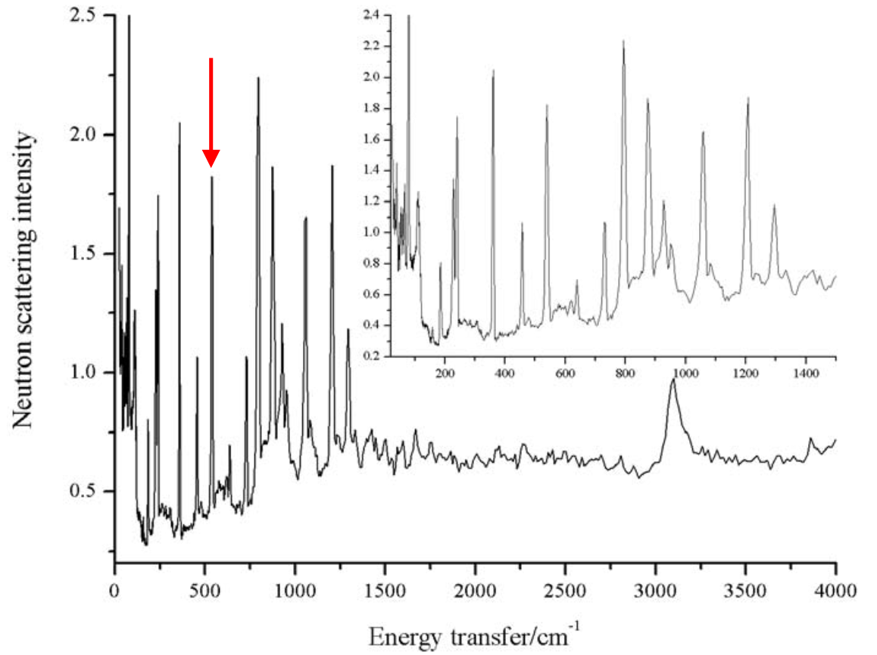
2,5-diiodothiophene

Slide 6
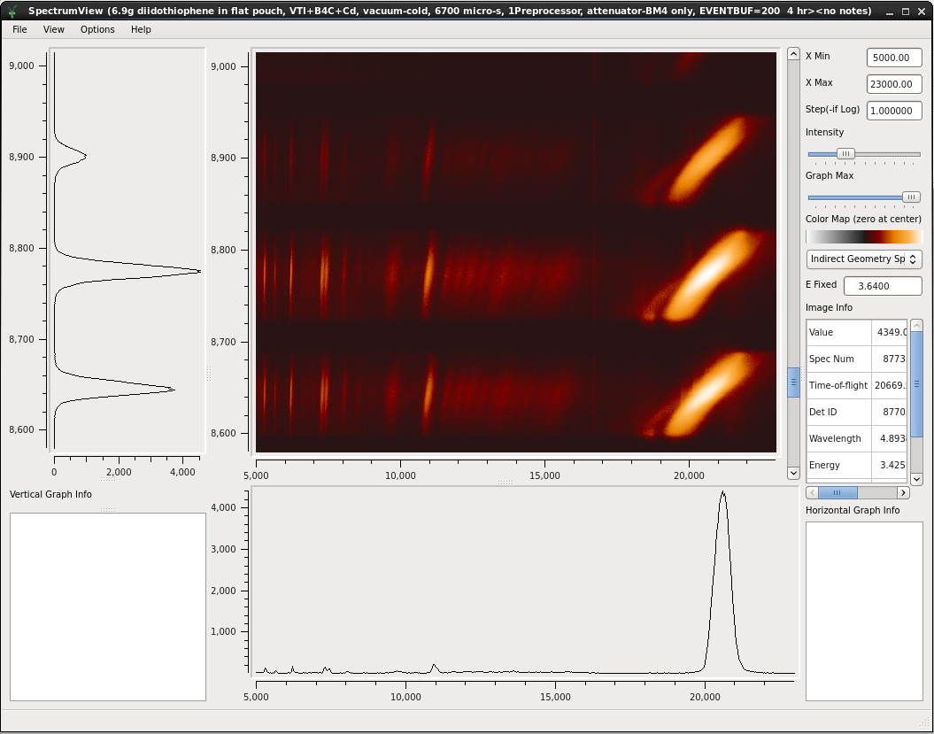
2,5-diiodothiophene: VISION

Slide 9
Using Mantid and the (Ef, L2) table to reduce VISION data
Mantid has a fixed Ef and L2 for all pixels.
We need to use our calibrated (Ef’, L2’) table for each individual pixel
To solve this issue, we use an effective Ef’’ defined as
Extract spectrum on each pixel, plug Ef’’ into ConvertUnits(), we have the correct initial energy, and error in final energy can be fixed.
ConvertUnits can to be more flexible to allow user-provided parameters

Slide 10
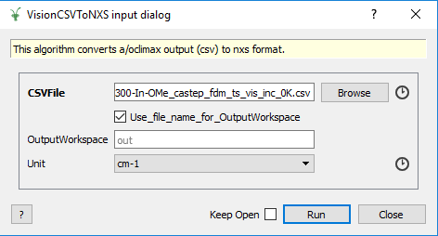
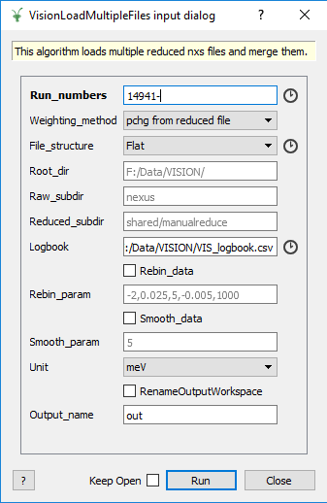
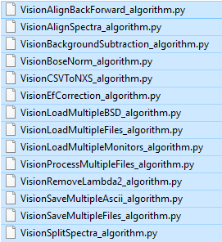
VISION data processing scripts and algorithms

Slide 11
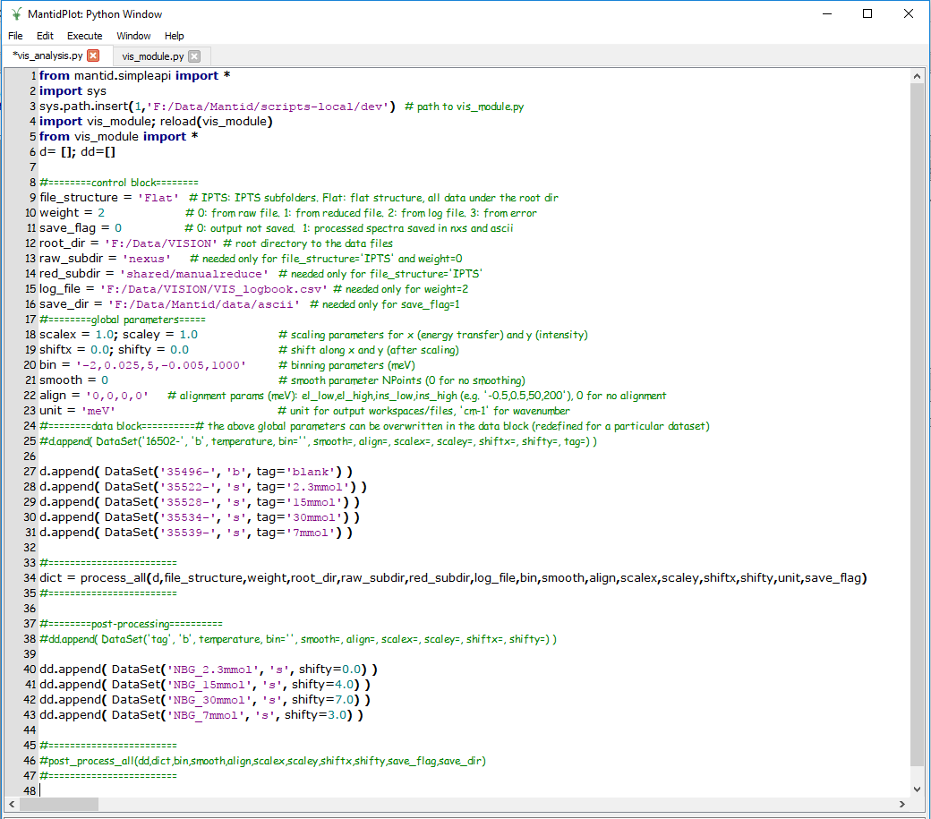

Slide 12
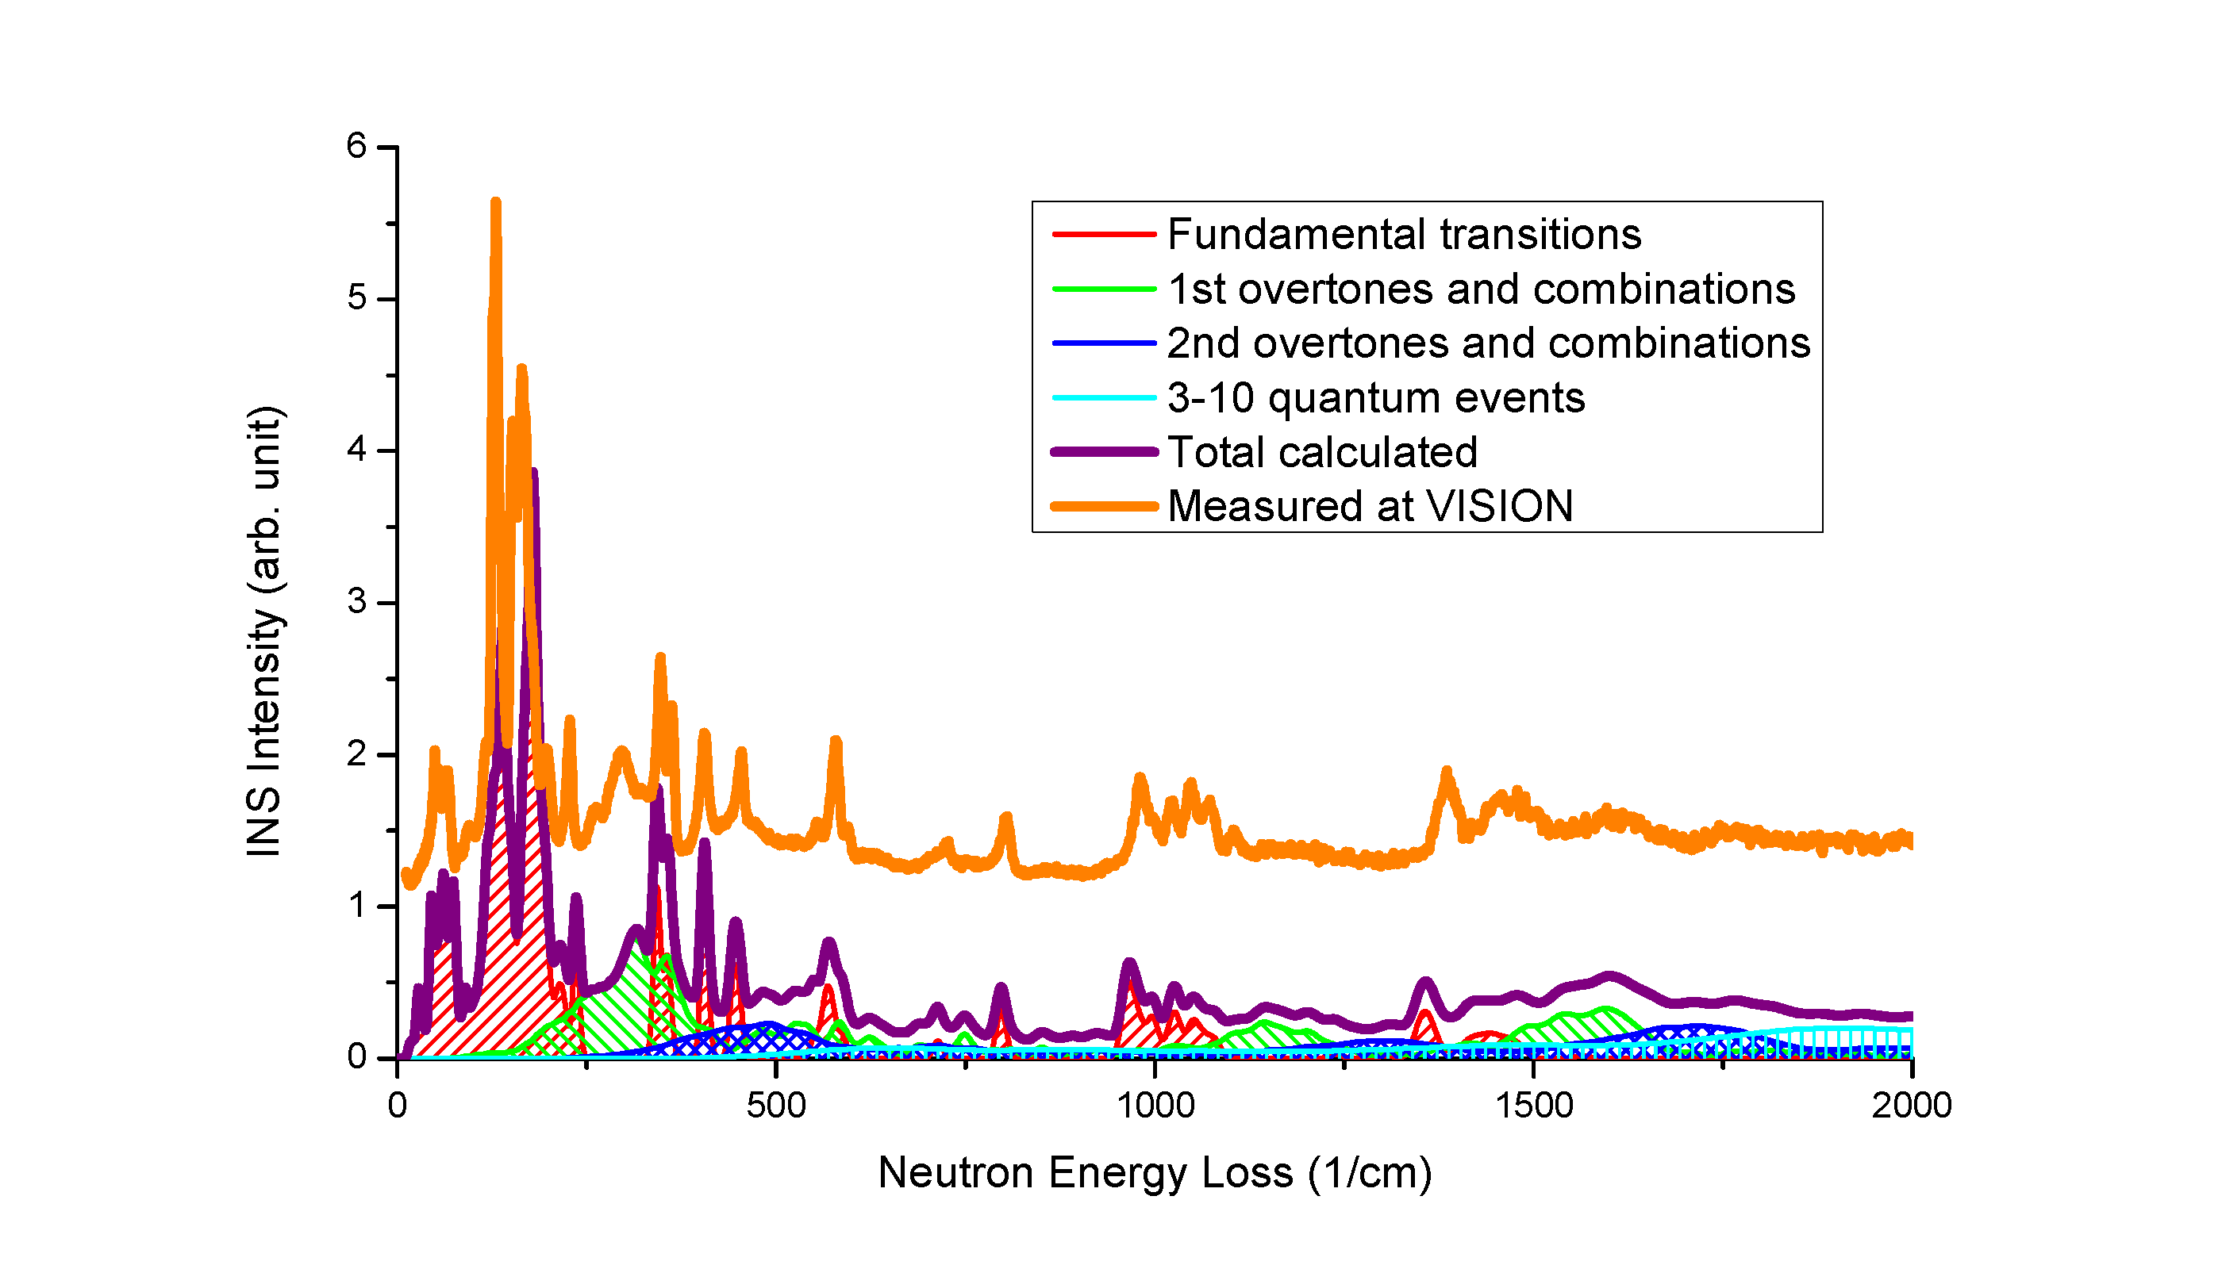
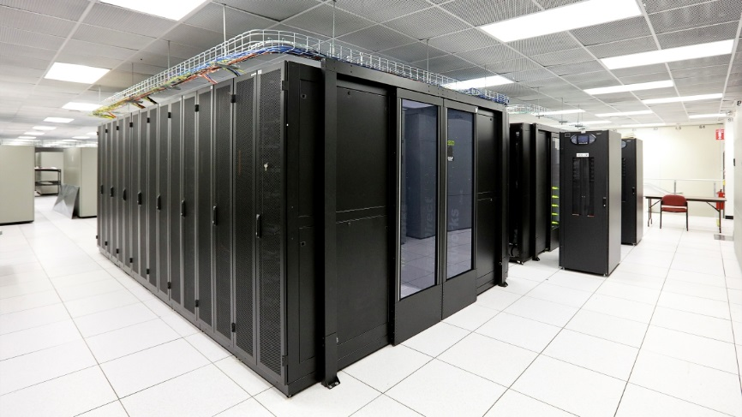

Integrated modeling for data interpretation
VISION and VirtuES (Virtual Experiments in Spectroscopy)
Dual 16 core Intel Haswell E5-2698v3 3.2 GHz Processors per node
50 compute nodes, 1600 (non-hyperthreaded) cores
128 GB memory/node, 6.4 TB Total memory
Each node has 10Gbe and Infiniband networking for connectivity.
Installed as part of the ORNL Compute and Data Environment for Science (CADES)
Computer modeling is crucial to understand and interpret INS data.
CASTEP
VASP
QE
CP2K
Gaussian
Vibrational modes and frequencies
INS simulation (OClimax)
Simulated INS spectra
Measured INS spectra
Sample
VISION
Data reduction and analysis (Mantid)
Measured diffraction
Structure-dynamics correlation
Understanding mechanisms and properties at atomic level
Peak assignment
(An)harmonicity
Mapping out the local potential energy profile using finite displacement, frozen phonon, molecular dynamics
Phase transition
Revealing the kinetics and the transition pathway

Slide 13
VirtuES helped users to make decisions on-the-fly
[yyc@or-condo-login02 CF3SO2OH]$ ls -lhtr
-rw-r--r-- 1 yyc users 3.6K Nov 4 15:50 F3CSO2OH.cell
-rw-r--r-- 1 yyc users 1.1K Nov 4 15:50 F3CSO2OH.param
-rw-r--r-- 1 yyc users 3.9K Nov 4 15:51 F3CSO2OH_PhonDOS.cell
-rw-r--r-- 1 yyc users 735 Nov 4 15:52 F3CSO2OH_PhonDOS.param
-rw-r----- 1 yyc users 1.1M Nov 4 16:46 F3CSO2OH.castep
-rw-r----- 1 yyc users 7.3M Nov 5 06:15 F3CSO2OH_PhonDOS.phonon
-rw-r----- 1 yyc users 232K Nov 5 06:15 F3CSO2OH_PhonDOS.castep
-rw-r--r-- 1 yyc users 3.3M Nov 5 08:56 CF3SO2OH.aclimax
[yyc@analysis-node02 manualreduce]$ ls -lhtr
-rw-rwx---+ 1 yyc users 2.2M Nov 5 12:34 VIS_20557_5K_for_0.9hr.nxs
-rw-rwx---+ 1 yyc users 2.2M Nov 5 13:28 VIS_20559_50K_for_0.9hr.nxs
-rw-rwx---+ 1 yyc users 2.2M Nov 5 14:23 VIS_20561_75K_for_0.9hr.nxs
-rw-rwx---+ 1 yyc users 2.2M Nov 5 15:56 VIS_20563_100K_for_0.9hr.nxs
-rw-rwx---+ 1 yyc users 2.2M Nov 5 17:21 VIS_20565_125K_for_0.9hr.nxs
-rw-rwx---+ 1 yyc users 2.2M Nov 5 18:44 VIS_20567_150K_for_0.9hr.nxs
-rw-rwx---+ 1 yyc users 2.2M Nov 5 20:23 VIS_20570_175K_for_1.2hr.nxs
-rw-rwx---+ 1 yyc users 2.2M Nov 5 21:58 VIS_20572_200K_for_1.2hr.nxs
-rw-rwx---+ 1 yyc users 2.2M Nov 5 23:29 VIS_20574_225K_for_1.2hr.nxs
-rw-rwx---+ 1 yyc users 2.2M Nov 6 01:00 VIS_20576_250K_for_1.2hr.nxs
-rw-rwx---+ 1 yyc users 2.2M Nov 6 02:28 VIS_20578_275K_for_1.2hr.nxs
-rw-rwx---+ 1 yyc users 2.2M Nov 6 03:57 VIS_20580_300K_for_1.2hr.nxs
Simulation was started at the beginning of the experiment. By the time when experimental data were collected, the calculation was already finished with theoretical predication available to be compared with experiment. This eventually led to a critical decision made by the user (see next slide).

Slide 14
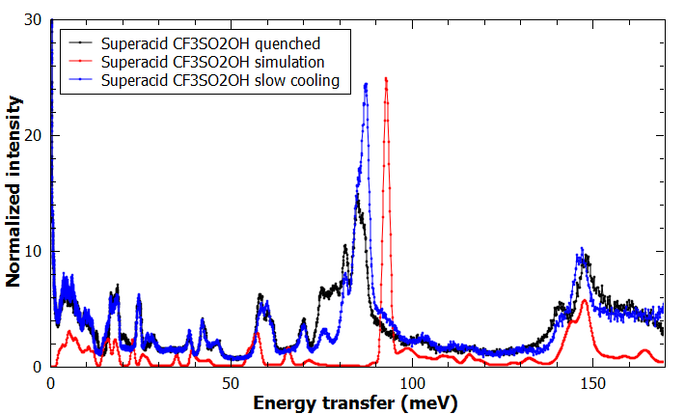
VirtuES helped users to make decisions on-the-fly
Sample

Slide 15
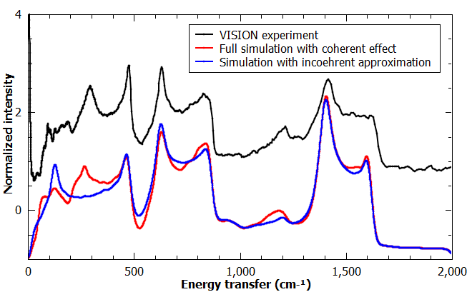
VirtuES helped to obtain insight from the experimental data

Slide 16
Install OCLIMAX (with Docker running)
For Linux/Mac (or Virtual Box on Windows)
For Windows (Native Windows 10)
For help
Open a terminal, run:
$ curl -s http://eclipseice.ornl.gov/downloads/iceman/oclimax/getoclimax | bash
$ oclimax pull
That’s it!
Visit http://eclipseice.ornl.gov/downloads/iceman/oclimax
Download oclimax.bat to your working directory
Open the Command Prompt “cmd”, go to the working directory, run:
$ oclimax.bat pull
$ oclimax help (Linux/Mac)
$ oclimax.bat help (Windows)

Slide 17
Convert your files to OCLIMAX input file
For help
Examples
Currently supports:
$ oclimax convert -help
CASTEP
VASP OUTCAR
VASP+phonopy
CP2K
Quantum Espresso
Gaussian
ORCA
NWChem
Dmol
RMG
Convert CASTEP output to out.aclimax file
$ oclimax convert -c yourfile.phonon
Convert CASTEP output to yourfile.aclimax file
$ oclimax convert -c yourfile.phonon -a yourfile
Convert CASTEP output to yourfile.oclimax file
$ oclimax convert -c yourfile.phonon -o yourfile
Convert CP2K output to yourfile.aclimax file
$ oclimax convert -cp2k yourfile.mol -a yourfile
Convert VASP+Phonopy output to yourfile.oclimax file
$ oclimax convert -vp POSCAR-unitcell mesh.yaml -o yourfile

Slide 18
Run OCLIMAX
By default, OCLIMAX calculates VISION spectra with standard parameters. To do this, run:
The output files of this run include:
To run the simulation with different parameters, you may edit the parameter file, and then run
$ oclimax run yourfile.oclimax
yourfile*.csv: The simulated INS spectra for VISION
yourfile.params: The (default) parameters used for this calculation
$ oclimax run yourfile.oclimax yourfile.params

Slide 19
Parameters for OCLIMAX calculation
# General parameters
TASK = 1 # 0:inc approx. 1:full coh+inc. 2: single crystal coh
INSTR = 3 # 0:VISION 1:general indirect 2:general direct 3:Q-omega mesh
TEMP = 293.00 # Temperature [K]
E_UNIT = 1 # Energy unit [eu] (0:cm-1,1:meV,2:THz)
OUTLEV = 0 # 0:standard output, 1:restart file, 2:SPE file, 3:full output
# E parameters
MINE = 0.200 # Energy range (minimum) to calculate [eu]
MAXE = 125.00 # Energy range (maximum) to calculate [eu]
dE = 0.200 # Energy bin size [eu]
ECUT = 0.300 # Exclude modes below this cutoff energy [eu]
# Q parameters
MINQ = 0.10 # Q [1/Ang] range (minimum) to calculate (INSTR=3)
MAXQ = 7.50 # Q [1/Ang] range (maximum) to calculate (INSTR=3)
dQ = 0.10 # Q [1/Ang] bin size (INSTR=3)
QRES = 0.10 # Q resolution [1/Ang] (INSTR=3)
# Geometry parameters
THETA = 0.0 60.0 # List of scattering angles [degree] (INSTR=1 or 2)
# Indirect geometry parameters
EF = 32.00 # Final energy [eu] (INSTR=1)
RES0 = 8.00 # Energy res [eu], constant (INSTR=0 or 1). -1:no res func
RES1 = 0.500E-02 # Energy res [const], x term (INSTR=0 or 1)
RES2 = 0.100E-06 # Energy res [1/eu], x^2 term (INSTR=0 or 1)
# Direct geometry parameters
EI = 125.00 # Incident energy [eu] (INSTR=2)
RES = 1.50 # Energy res [eu] (INSTR=2 or 3). -1:no res, 0:calc res
L1 = 11.60 # L1 [m] for DGS (INSTR=2 or 3, RES=0)
L2 = 2.00 # L2 [m] for DGS (INSTR=2 or 3, RES=0)
L3 = 3.00 # L3 [m] for DGS (INSTR=2 or 3, RES=0)
dt_m = 28.74 # dt_m [us] for DGS (INSTR=2 or 3, RES=0)
dt_ch = 13.77 # dt_ch [us] for DGS (INSTR=2 or 3, RES=0)
dL3 = 3.00 # dL3 [cm] for DGS (INSTR=2 or 3, RES=0)
# Additional parameters
WING = 0 # Wing calculation (0:no wing,1:isotropic,2:ST tensor)
A_ISO = 0.0350 # Isotropic A_external for wing calculation
W_WIDTH = 150.0 # Energy width [eu] of initial wing
MASK = 1 # Set 1 to apply mask on Q-w map (INSTR=3)
MAXO = 10 # Maximum order of excitation (up to 10)
NS = 6.0 # Number of sigma in resolution function
HKL = 0 0 0 # HKL (TASK=2 and INSTR=3)
Q_disp = 1.00 0.00 0.00 # Q vector dir (TASK=2 and INSTR=3)
Powder and single crystal
Coherent and incoherent
Temperature effect
Wing calculation for single molecules
Instrument geometry and resolution

Slide 20
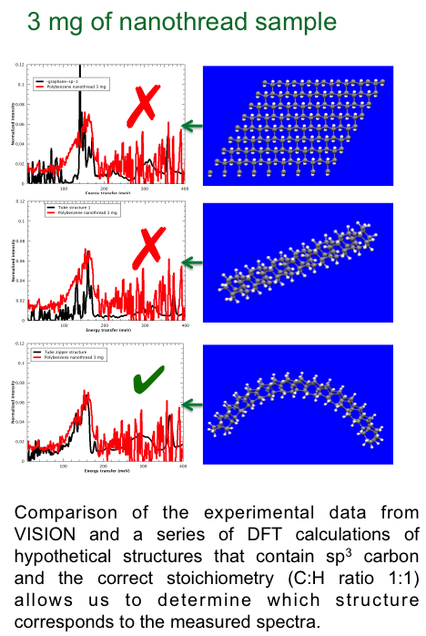
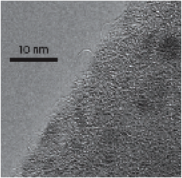
VISION: Unprecedented capabilities and opportunities
Collaboration with Malcolm Guthrie, John Badding, Vin Crespi. Original publication on carbon nanothreads: Nature Materials, 14, 43 (2014)

Slide 21
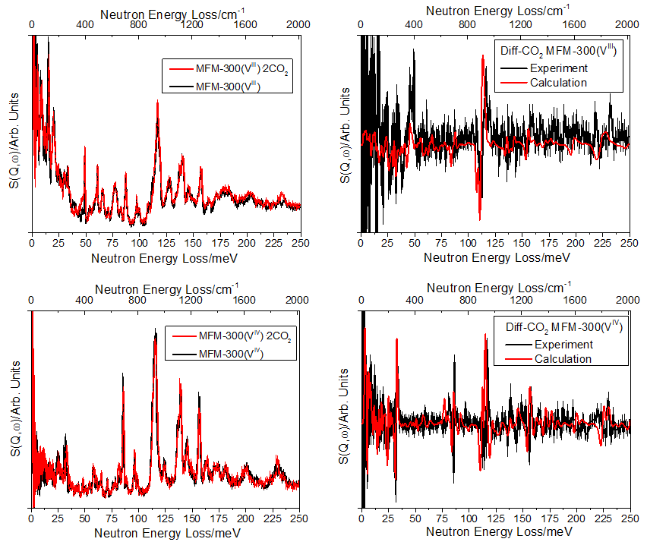
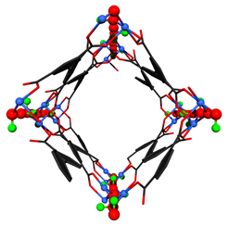
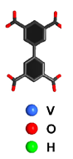
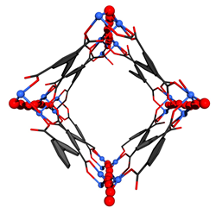
NOTT-V MOF and CO2 adsorption
Collaboration with Sihai Yang and Martin Schroder at University of Manchester.

Slide 22
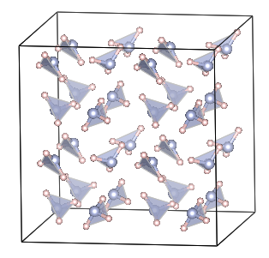
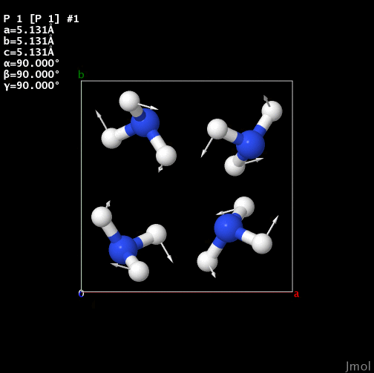
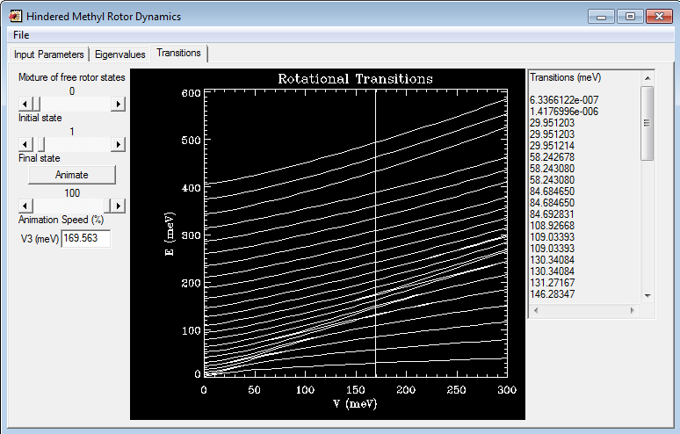
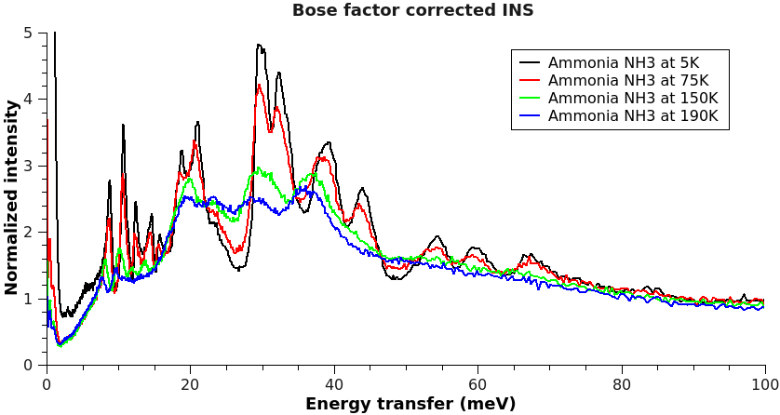
Hydrogen in a “simple” molecular solid: Beyond DFT and harmonic approximation
Libration/rotation of NH3 group
Calculated INS using larger amplitude displacements
A 2x2x2 supercell of the ammonia (NH3)
DFT calculated energy barrier for rigid rotation of NH3: 180 meV
Energy barrier solved from the rotor model : 170 meV

Slide 23
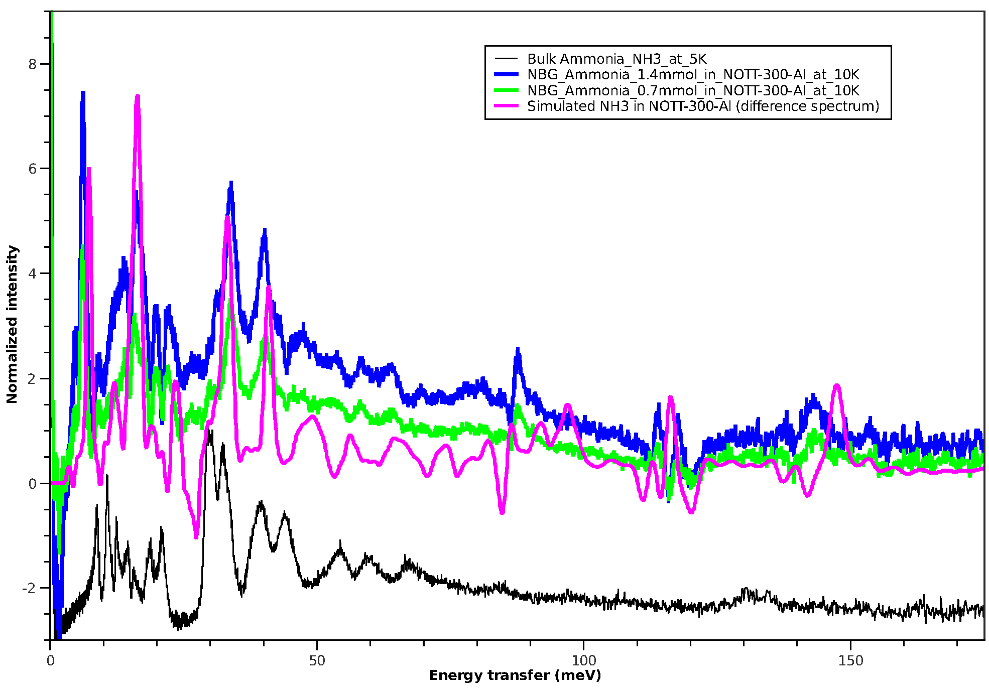
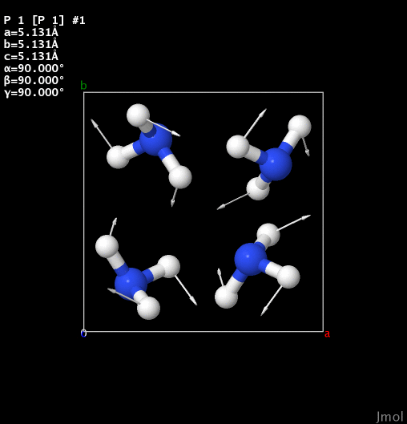
Solid NH3 vs NH3 in MOF
Libration in solid NH3
Libration in adsorbed NH3
From anharmonic to harmonic

Slide 24
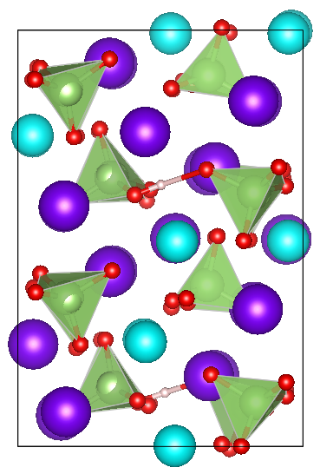
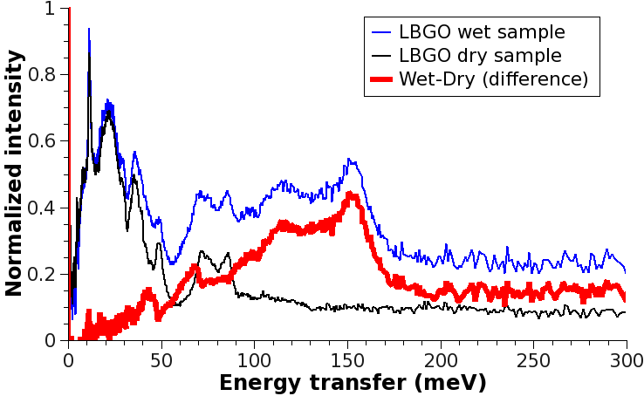
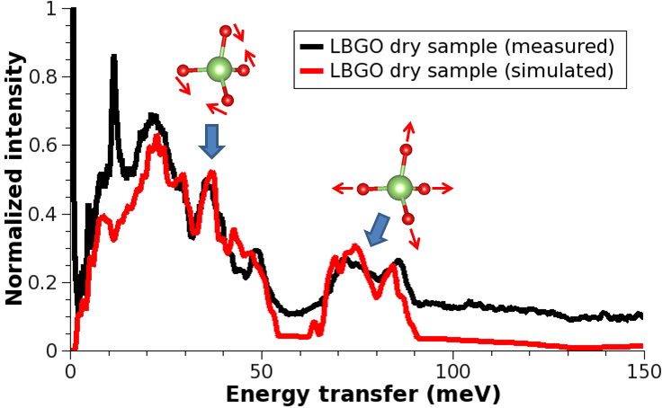
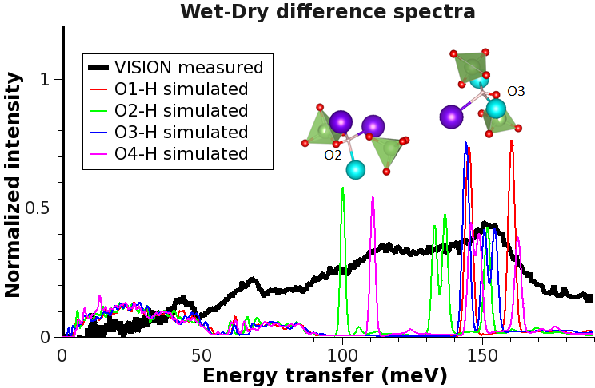
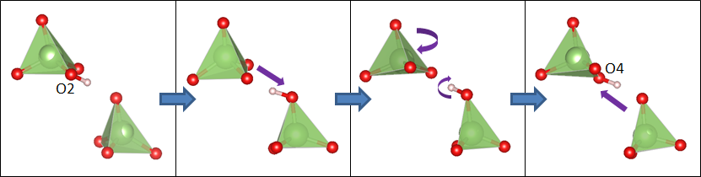
Hydrogen in proton conductors
La_{1−x}Ba_{1+x}GaO_{4−x/2}(H₂O)_{y}
x=0.25, y=0.0625
La: cyan
Ba: purple
Ga: green
O: red
VISION is sensitive to very small amount of protons
VISION+modeling identifies various local chemical environment for the protons, and reveals the proton transport mechanism

Slide 25
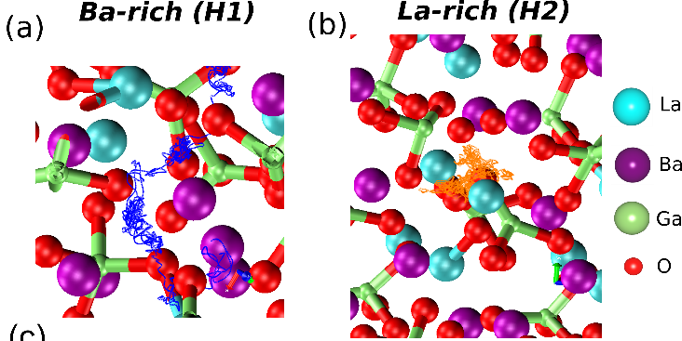
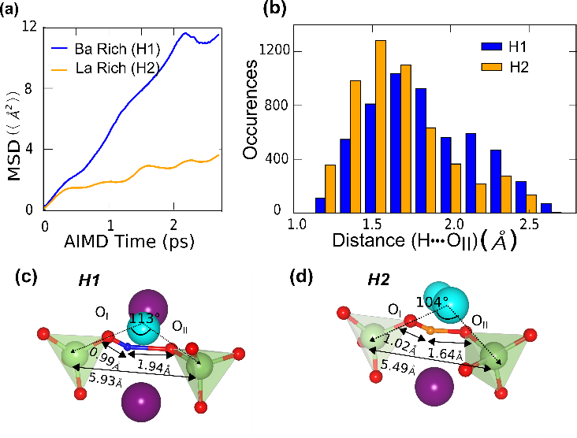
Hydrogen in proton conductors
Cheng Y.Q., Balachandran J., Bi Z., Bridges C.A., Paranthaman M.P., Daemen L.L., Ganesh P., Jalarvo N., The influence of the local structure on proton transport in a solid oxide proton conductor La0.8Ba1.2GaO3.9 Journal of Materials Chemistry A, 5, 15507–15511 (2017).

Slide 26
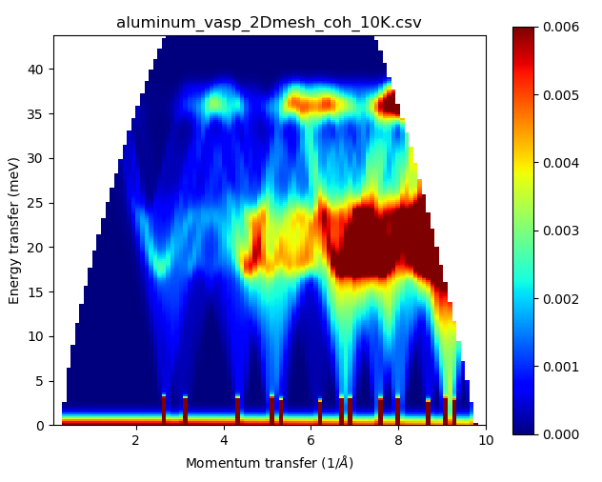
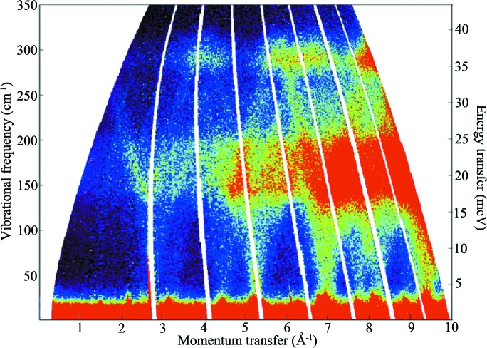
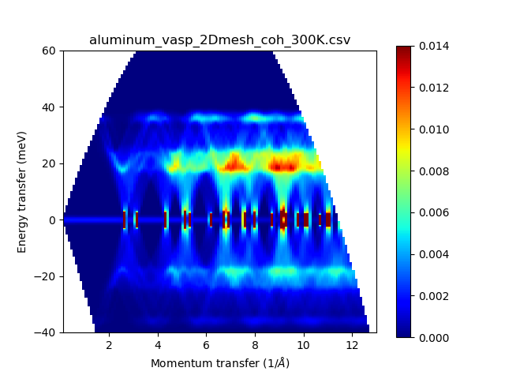
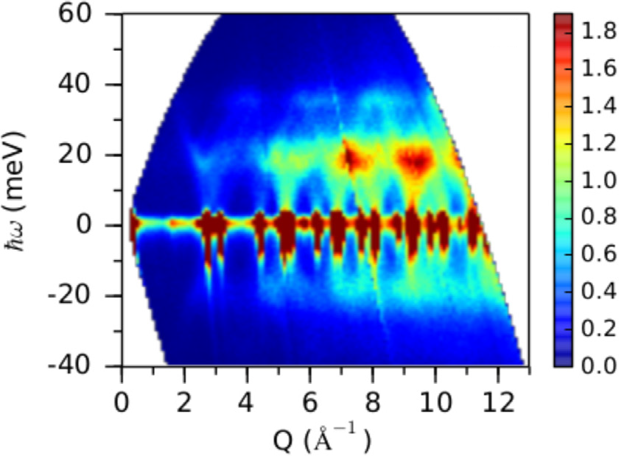
Aluminum
MARI (10K)
OClimax (10K)
ARCS (RT)
OClimax (RT)

Slide 27
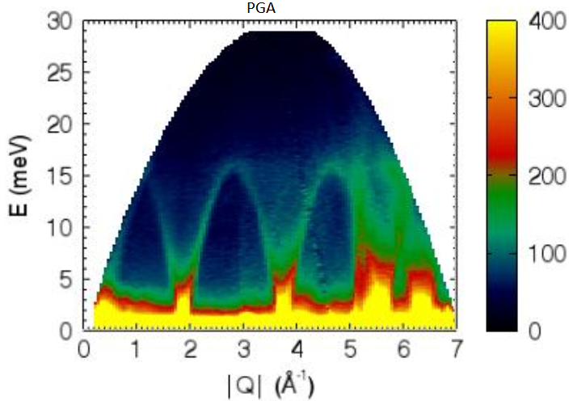
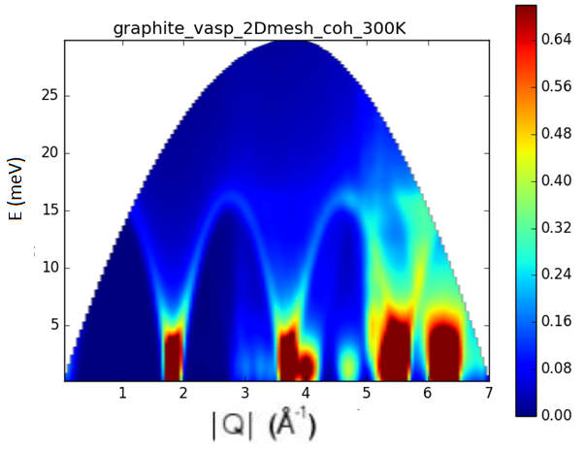
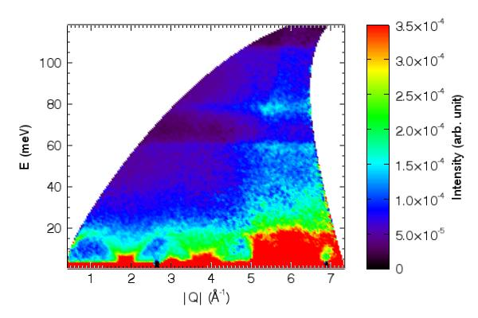
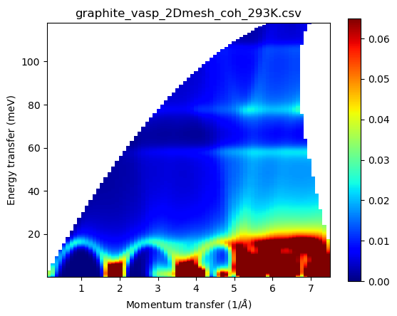
Graphite
ARCS
OClimax
Sequoia
OClimax

Slide 28
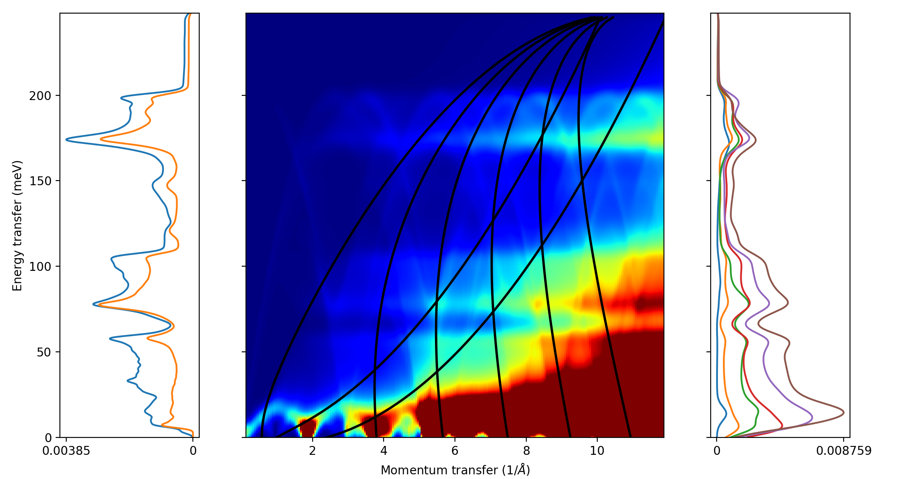
Graphite
VISION
S(Q,ω) Map
SEQUOIA
ARCS
etc

Slide 29
The modeling effort at VISION has been supported by two LDRD projects: VirtuES and ICE-MAN

Slide 30
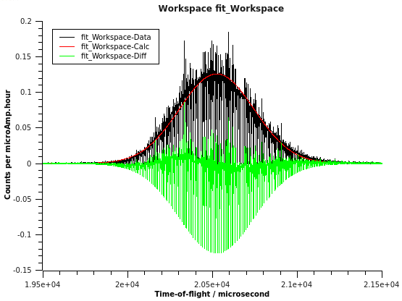
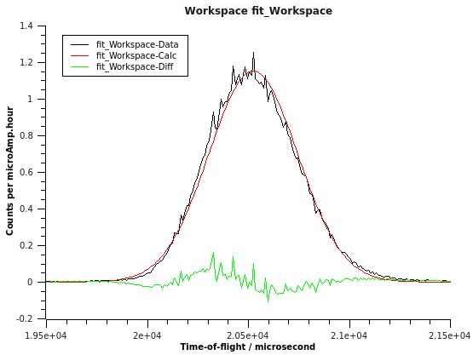
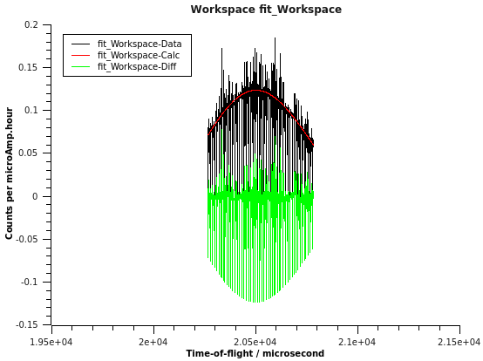
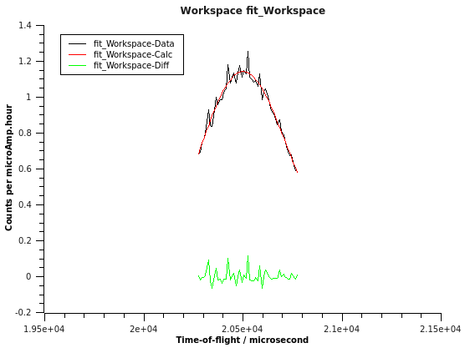
Peak fitting: elastic peak
DeltaX=1
Center of mass from data: 20525.8
Full Gaussian peak position: 20524.1
Half Gaussian peak position: 20485.2
DeltaX=10
Center of mass from data: 20521.4
Full Gaussian peak position: 20524.2
Half Gaussian peak position: 20494.5

Slide 31
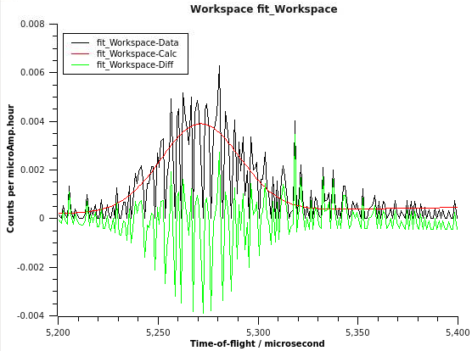
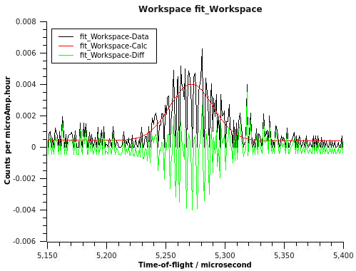
Peak fitting: inelastic peak
DeltaX=1
Center of mass from data: 5283.1
Full Gaussian peak position: 5271.3
DeltaX=1
Center of mass from data: 5270.9
Full Gaussian peak position: 5271.7

Slide 32
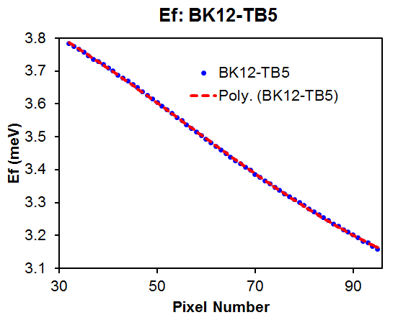



Fitting the Ef and L2 curves

Slide 33

Before and after calibration: elastic line

Slide 34







Integrated modeling: peak assignment and data interpretation
Gate closed
Gate open
2.9 Å
3.4 Å
Measured (upper panel) and simulated (lower panel) INS spectra of blank ZIF-8 and ZIF-8+N2.
Structure of blank ZIF-8 and ZIF-8 loaded with N₂.
M.E. Casco, Y.Q. Cheng, L.L. Daemen, D. Fairén-Jiménez, E.V. Ramos-Fernández, A.J. Ramirez-Cuesta, and J. Silvestre-Albero, Chem. Comm. (2016) 52, 3639

Slide 35






Integrated modeling: peak assignment and data interpretation
M1
M1’
M2
M3
mode | description
M1 M1’ | Methyl torsion
M2 | Methyl bending Out-of-plane
M3 | Methyl bending In-plane
M4 | Ring deformation
M5 | Ring deformation
M6 | C-H wagging
M7 | C-H twisting
M8 | C-H bending
M9 | C-H rocking
M1
M1’
M2
M3
M6
M7
M4
M8
M9
M5
M6
M9

Slide 36



Observing the breathing phenomena in a nano-metal-organic-framework with neutrons
Scientific Achievement
Inelastic neutron scattering (INS) identified the breathing modes that reflect the structural flexibility of ZIF-7, a metal-organic-framework (MOF). The INS spectra revealed significant changes in the low energy peaks upon N₂ adsorption. The corresponding breathing modes were visualized and the mechanism was elucidated by DFT calculations.
Significance and Impact
Understanding structural flexibility of nanoporous solids upon external stimuli (for instance upon a pressure or temperature change, or upon gas exposure) is of paramount importance to define their performance in subsequent applications (e.g., sensors, gas separation units, drug-delivery devices, etc.). The low energy breathing modes are often closely related to the response of the material to external stimuli. This work demonstrates the unique advantage of neutrons in characterizing these modes, especially for MOFs.
Research Details
The blank ZIF-7 sample, after evacuation, was first measured at 5K for INS spectrum.
The sample was then warmed to 77K in situ to load N₂.
The N₂-loaded ZIF-7 was then cooled to 5K to measure INS again.
ZIF-7 before N₂
ZIF-7 after N₂
Inelastic neutron scattering spectra (experiment at VISION versus simulation) of the ZIF-7 sample before and after incorporation of 1 bar N₂.
Inelastic neutron scattering experiment was performed at the VISION spectrometer of ORNL’s Spallation Neutron Source, which is a DOE Office of Science user facility.
C. Cuadrado-Collados et al. Understanding the breathing phenomena in nano-ZIF-7 upon gas adsorption. J. Mater. Chem. A, 2017, 5, 20938.

Slide 37
Catalytic hydrodeoxygenation of phenol
Main products:
Ru/Nb₂O₅:
Benzene
Cyclohexanol
Ru/ZrO₂:
Benzene
Cyclohexane
Ru/Al₂O₃:
Cyclohexane
Cyclohexanol
Ru/TiO₂:
Cyclohexanol

Slide 38

Catalytic hydrodeoxygenation of phenol
Shao, Y. et al. Selective production of arenes via direct lignin upgrading over a niobium-based catalyst. Nat. Commun. 8, 16104 (2017).
OH removal: strength of phenol chemisorption on the surface
Selectivity between the competitive processes of C_{aromatic}–O bond cleavage and C6-ring hydrogenation: reduction in C-O bond cleavage energy

Slide 39

INS signature of confined molecules in Polyoxometalates (POMs)
POMs are a group of well-defined metal-oxide molecular clusters at nano-scale with wide applications in catalysts and magnetically/electronically active materials design. They can be used to encapsulate molecules for various applications, such as drug delivery.
Panchao Yin*, et al. J. Am. Chem. Soc. DOI: 10.1021/jacs.5b11465.
Libration of confined water molecules
Signature of confined butyric acid

Slide 40







Neutron characterization of novel tire-derived carbon materials
A: CH2 twisting
B: CH2 wagging
C
D
A
B
E
F
G
C: CH2/CH3 rocking
E: SOH bending
D: CH2/CH3 bending
G: CH in-plane bending
The relative amount of hydrogen content, the bonding environment of hydrogen, as well as the degree of structural disorder in a group of tire-derived carbon materials are characterized by neutron scattering the computer simulation, shedding light on the electrochemical performance of these novel materials.
F: CH out-of-plane bending
Li, Y., Cheng, Y., Daemen, L.L., Veith, G.M., Levine, A.M., Lee, R.J., Mahurin, S.M., Dai, S., Naskar, A.K., Paranthaman, M.P., “Neutron vibrational spectroscopic studies of novel tire-derived carbon materials. Phys. Chem. Chem. Phys., 2017, 19, 22256.

Slide 41




First evidence of Ce-H formation on CeO₂
Surface O-H
Surface Ce-H
Surface Ce-H
Bulk Ce-H
Difference spectrum (reacted - unreacted)
Wu, Zili; Cheng, Yongqiang; Tao, Franklin (Feng); Daemen, Luke; Foo, Guo Shiou; Nguyen, Luan; Zhang, Xiaoyan; Beste, Ariana; Ramirez-Cuesta, Anibal. “Direct neutron spectroscopy observation of cerium hydride species on a cerium oxide catalyst” J. Am. Chem. Soc. 2017, DOI: 10.1021/jacs.7b05492.
Inelastic neutron scattering, combined with computer simulation, provides first direct evidence for the presence and conversion of surface and bulk Ce-H when ceria interacts with hydrogen. This is a key step to understand the hydrogen activation mechanism and in turn the hydrogenation performance of this material.
Surface Ce-H
Bulk Ce-H

